Slide 1
Introduction to Git
By Jonathan Salatan
Senior Consultant

Slide 2
In a glance
History
Types of SCM
Open-Source
Hands-On
Notes:
Brief History of SCM and Git
Three Categories of SCM
Hands-on
Under the Hood
Contribute to Open-Source Projects

Slide 3
History
History
“As with many great things in life, Git began with a bit of creative destruction and fiery controversy.” – Scott Chacon, Pro Git

Slide 4




About SCM & Git
I'm an egotistical bastard, and I name all my projects after myself. First 'Linux', now 'git'.
SCM
Earliest record of SCM is 1970s (CMS, SCCS)
Other popular SCMs were
Client-server: RCS(1982), CVS (1986), ClearCase (1992), Visual SourceSafe (1994), SVN (2000)
Distributed: BitKeeper (1998), Mercurial (2005)
.
Created by Linus Torvalds in 2005
As a replacement for the proprietary BitKeeper
Git means British English slang for unpleasant person
Created based on the ff. design criteria:
Speed
Simple design
Strong support for non-linear development (thousands of parallel branches)
Fully distributed
Able to handle large projects like the Linux kernel efficiently (speed and data size)
Notes:
Linux kernel
1991-2002: changes to the software were passed around as patches and archived files
2002: the Linux kernel project began using a proprietary DVCS system called BitKeeper
2005: the relationship between the community that developed the Linux kernel and the commercial company that developed BitKeeper broke down, and the tool’s free-of-charge status was revoked.
Meaning of Git:
Torvalds said: "I'm an egotistical bastard, and I name all my projects after myself. First 'Linux', now 'git'.“
The man page describes git as "the stupid content tracker“
replacement for the proprietary BitKeeper
The copyright holder of BitKeeper, Larry McVoy, had withdrawn free use of the product after claiming that Andrew Tridgell had reverse-engineered the BitKeeper protocols.
http://www.plasticscm.com/version-control-history.html
http://codicesoftware.blogspot.com/2010/11/version-control-timeline.html

Slide 5
Timeline of Major SCMs
Notes:
http://www.plasticscm.com/version-control-history.html
http://codicesoftware.blogspot.com/2010/11/version-control-timeline.html
Logos:
https://www.openhub.net/p/cvs

Slide 6
types of scm
Types of SCM
Local
Centralized
Distributed

Slide 7
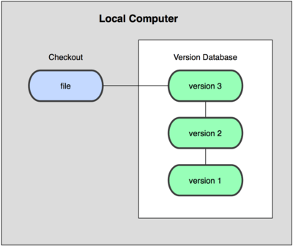
Local
(e.g., Time-stamped file/folder, RCS)
Notes:
Local
copy files into another directory (perhaps a time-stamped directory, if they’re clever)

Slide 8

Client-Server (Centralized)
(e.g., CVS, SVN, Visual SourceSafe, ClearCase)
Notes:
Centralized
PRO
collaborate with developers on other systems
this has been the standard for version control for many years
CON
the single point of failure that the centralized server represents
http://git-scm.com/book/en/Getting-Started-About-Version-Control

Slide 9
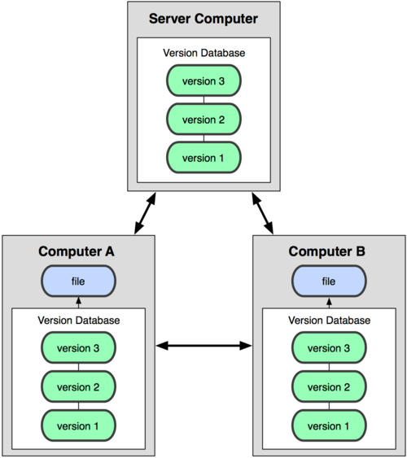
Distributed
(e.g., git, Mercurial, BitKeeper)
Notes:
Distributed – (Distributed Version Control Systems (DVCSs))
clients don’t just check out the latest snapshot of the files: they fully mirror the repository
http://git-scm.com/book/en/Getting-Started-About-Version-Control

Slide 10
Local vs Client-Server vs Distributed
Local
Centralized
Distributed
(e.g., Time-stamped file/folder, RCS)
(e.g., CVS, SVN, Visual SourceSafe, ClearCase)
(e.g., git, Mercurial, BitKeeper)
Notes:
Local
copy files into another directory (perhaps a time-stamped directory, if they’re clever)
Centralized
PRO
collaborate with developers on other systems
this has been the standard for version control for many years
CON
the single point of failure that the centralized server represents
Distributed – (Distributed Version Control Systems (DVCSs))
clients don’t just check out the latest snapshot of the files: they fully mirror the repository
http://git-scm.com/book/en/Getting-Started-About-Version-Control

Slide 11
BasicS
Hands-on
“If you can read only one chapter to get going with Git, this is it.
This chapter covers every basic command you need to do the vast majority of the things you’ll eventually spend your time doing with Git. ” – Scott Chacon, Pro Git (Git-Basics chapter)
Notes:
http://git-scm.com/book/en/Git-Basics
Setup
Initiate Git Repo
Recording Changes
Viewing Commit History
Undoing Things
Working with Remotes

Slide 12
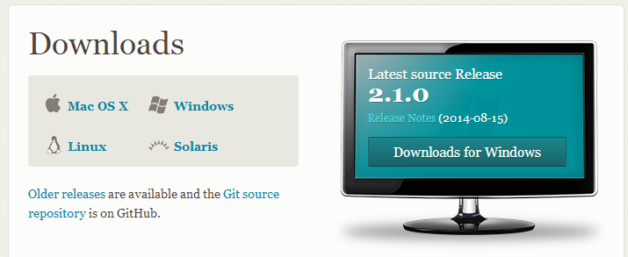
Hands-on
Setup - Install
http://git-scm.com/downloads

Slide 13

Hands-on
Setup – Config
system
Linux:
/etc/gitconfig
Windows: D:\Users\$USER\AppData\Local\Programs\Git\etc
Linux:
~/.gitconfig
Windows:
D:\Users\$USER\.gitconfig
global
Linux:
.git/config
Windows:
D:\$PROJECT_DIR\.git\config
project-specific
Notes:
/etc/gitconfig (values for every user on the system and all their repositories)
~/.gitconfig (user-specific)
.git/config (repository-specific)
config file in the Git directory of whatever repository you’re currently using: Specific to that single repository
Note: Each level overrides values in the previous level, so values in .git/config trump those in /etc/gitconfig.

Slide 14
Hands-on
Setup – Identity
Your Identity (user name and email)
$ git config --global user.name “Juan Dela Cruz“
$ git config --global user.email jdelacruz@example.com
List all config values
$ git config --list
Notes:
Other Configs:
http://git-scm.com/book/en/Getting-Started-First-Time-Git-Setup
This is important because every Git commit uses this information, and it’s immutably baked into the commits you pass around:

Slide 15
Hands-on
Initialize - Local
LOCAL
git-training
src
target
git-training
src
target
.git
$ git init

Slide 16
Hands-on
Initialize - Remote
Intranet, GitLab, GitHub, etc.
LOCAL
git-training
src
target
.git
git-training
src
target
$ git clone
Common Protocols:
git://
http(s)://
ssh
Notes:
Initializing a Repository (Existing Directory)
$ git init
$ git add
$ git commit
Cloning an Existing Repository
$ git clone git://github.com/schacon/grit.git
$ git clone git://github.com/schacon/grit.git mygrit
Intranet, GitLab, GitHub, etc.

Slide 17
Hands-on
Recording Changes
Check status
$ git status
LOCAL
create file
Windows: $ echo null>file
Linux: $ touch <file>
add to staging area
$ git add <file>…
Commit
$ git commit –m <comment>
project
.git
new.txt
Notes:
Task: Add a file
Commands:
$ git status
$ touch new.txt
$ git status
$ git add new.txt
$ git status
Checking the Status of Your Files
Tracking New Files
Staging Modified Files
Ignoring Files
Viewing Your Staged and Unstaged Changes
Committing Your Changes
Skipping the Staging Area
Removing Files
Moving Files

Slide 18

Under the Hood

Slide 19




Operation Locations
is a simple file; sometimes referred to as the index
modify, add, delete
modified
staged
Command git to include what goes into your next commit
committed
Notes:
Git Directory - is where Git stores the metadata and object database for your project. This is the most important part of Git, and it is what is copied when you clone a repository from another computer.
Working Directory - is a single checkout of one version of the project. These files are pulled out of the compressed database in the Git directory and placed on disk for you to use or modify.
Staging Area - is a simple file, generally contained in your Git directory, that stores information about what will go into your next commit. It’s sometimes referred to as the index, but it’s becoming standard to refer to it as the staging area.

Slide 20
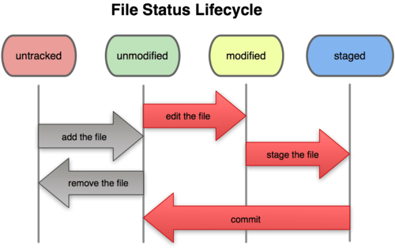
File Status Lifecycle

Slide 21
Hands-on
Recording Changes
Check status
$ git status
LOCAL
Update file
add to staging area
$ git add <file>…
Commit
$ git commit
project
.git
new.txt
Notes:
Task: Add a file
Commands:
$ git status
$ touch new.txt
$ git status
$ git add new.txt
$ git status

Slide 22
Operation Locations
is a simple file; sometimes referred to as the index
?
?
?
?
?
?
Notes:
Git Directory - is where Git stores the metadata and object database for your project. This is the most important part of Git, and it is what is copied when you clone a repository from another computer.
Working Directory - is a single checkout of one version of the project. These files are pulled out of the compressed database in the Git directory and placed on disk for you to use or modify.
Staging Area - is a simple file, generally contained in your Git directory, that stores information about what will go into your next commit. It’s sometimes referred to as the index, but it’s becoming standard to refer to it as the staging area.

Slide 23
Exercise
LOCAL
create a file
add to staging area
update file (do not stage)
commit
project
.git
new.txt
Will the updated file be committed?

Slide 24
Hands-on
Recording Changes
Ignoring Files
Modify .gitignore
Skipping the Staging Area
$ git commit –a –m <comment>
Removing Files
$ git rm
$ git rm --cached <file>
Moving Files
$ git mv
if you forgot to add something to your .gitignore file and accidentally staged it
Convenience function for:
$ mv README README.txt
$ git rm README
$ git add README.txt
Notes:
$ git rm --cached readme.txt
keep the file in your working tree but remove it from your staging area
keep the file on your hard drive but not have Git track it anymore
This is particularly useful if you forgot to add something to your .gitignore file and accidentally staged it, like a large log file or a bunch of .a compiled files.

Slide 25
Hands-on
Viewing History
$ git log
--stat
--pretty
format
--graph
$ git log --pretty=format:"%h %s" --graph
$ git log --pretty=oneline --graph
$ gitk
Notes:
http://git-scm.com/book/en/Git-Basics-Viewing-the-Commit-History
Steps:
Create branch
Commit to branch
Checkout master
Commit to master
Merge branch

Slide 26
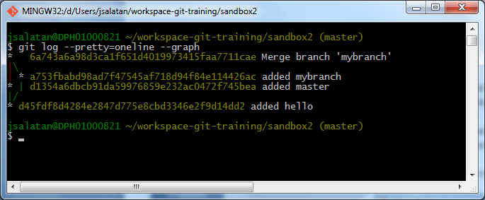
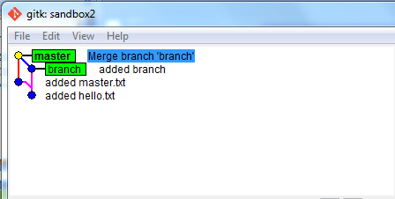
Activity
Create branch
Checkout master
Commit to master
Merge branch
Commit to branch
$ git checkout –b <branchname>
$ git commit -a -m <comment>
$ git checkout master
$ git commit -a -m <comment>
$ git merge <branch> master
Show log
$ git log --pretty=format:"%h %s" --graph
Notes:
Create branch
Commit to branch
Checkout master
Commit to master
Merge branch

Slide 27
Hands-on
Undoing Things
Changing last commit
Add new file
Stage
$ git add
Commit
$ git commit
Added forgotten file
$ git add
Amend Commit
$ git commit –amend
Check status
Notes:
Changing Your Last Commit
$ git commit --amend

Slide 28
Hands-on
Undoing Things
Unstaging a Staged File
Add new file
Stage
$ git add
Git Reset
$ git reset HEAD <file>…
Check Status
Notes:
Unstaging a Staged File
$ git reset HEAD <file>…

Slide 29
Hands-on
Undoing Things
Unmodifying a Modified File
Modify file
Checkout
$ git checkout -- <file>…
Check status
Notes:
Unmodifying a Modified File
$ git checkout -- <file>...

Slide 30
Hands-on
Undoing Things
Unmodifying a Staged File
(Return to initial state)
Modify file
Checkout
$ git checkout -- <file>…
Stage
$ git add
Reset
$ git reset HEAD <file>…

Slide 31
Working w/ Remotes
Showing Your Remotes
$ git remote
$ git remote -v
Adding Remote Repositories
$ git remote add [shortname] [url]
$ git fetch
pulls the data to your local repository — it doesn’t automatically merge it
Notes:
Showing Your Remotes
Adding Remote Repositories
Fetching and Pulling from Your Remotes
Pushing to Your Remotes
Inspecting a Remote
Removing and Renaming Remotes

Slide 32
Working w/ Remotes
Fetching and Pulling from Your Remotes
git fetch [remote-name]
git pull
Pushing to Your Remotes
git push [remote-name] [branch-name]
$ git push origin master

Slide 33
Working w/ Remotes
Inspecting a Remote
git remote show
$ git remote show origin
Removing and Renaming Remotes
git remote rename
$ git remote rename origin orgn
git remote rm
$ git remote rm origin

Slide 34
Contributing to open-source
Open-Source
History
Definition
Process
Benefits
Demo

Slide 35
Famous Git Repos
Github
Bitbucket
Gitlab
Gitorious

Slide 36
Advanced topics (NOT COVERED)
Branching
Git on the Server
Distributed Git
Git Tools
Customizing Git
Git and Other Systems
Git Internals

Slide 37
Exercise
Initialize a repo in existing directory
Clone a repo shared thru the intranet
Clone a project from gitlab
Creating your own project and uploading to public repo (Github, GitLab, etc.)
Branching

Slide 38
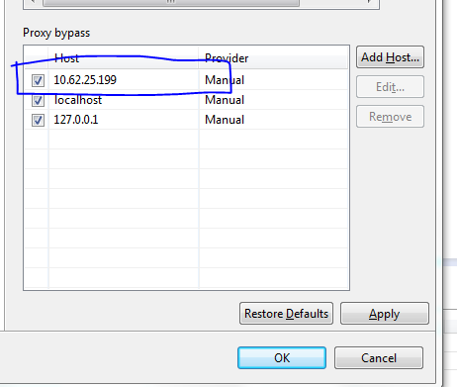
Clone an open-source project from GitLab
Bypass proxy in Eclipse:
Window > Preferences
General > Network Connections > Proxy bypass

Slide 39
Project-Kudos
Responsive Web Design
Modules:
Login
User Registration
Member’s Page
Technologies:
Spring, Spring Security, Hibernate, Thymeleaf
Notes:
https://github.com/kolorobot/spring-mvc-quickstart-archetype

